Slide 1

Forecasting and Monitoring Hospitalization Trends from Respiratory Viruses in Kenya: A Time Series Analysis by County
Group 10
Okech Maxmillan
Diana Ogeto
Lydia Mangoa
Eric Miriti
Christine Ambasa
Notes:
Greetings
Group members
Title

Slide 2

Business Understanding
Demonstrate how data-driven forecasting using U.S. hospitalization data can help Kenya anticipate respiratory virus surges, improve resource allocation, and strengthen public health response once local data systems are in place.

Slide 3

Problem Statement
Kenya lacks real-time surveillance for respiratory virus hospitalizations.
This project uses U.S. data to demonstrate how forecasting can guide future public health response and planning once local data systems are established.

Slide 4

Objectives
Monitor, model, and forecast respiratory virus-related hospitalizations across U.S. regions
Support healthcare planning, outbreak response, and policy-making
Detect seasonal patterns in hospitalization trends
Forecast future spikes or declines in respiratory cases
Provide real-time dashboards for public health decision-making

Slide 5

Stakeholders
MOH and local health departments
Hospital administrators and planners
Epidemiologists and public health researchers
Policy-makers and emergency response teams

Slide 6

Data Understanding
This project leverages a dataset derived from publicly available U.S. health records on the US.gov repository.
Weekly COVID-19 hospital admissions – used as the primary target variable.
Handling missing values and skewness of the dataset through imputation using the mean and median.

Slide 7
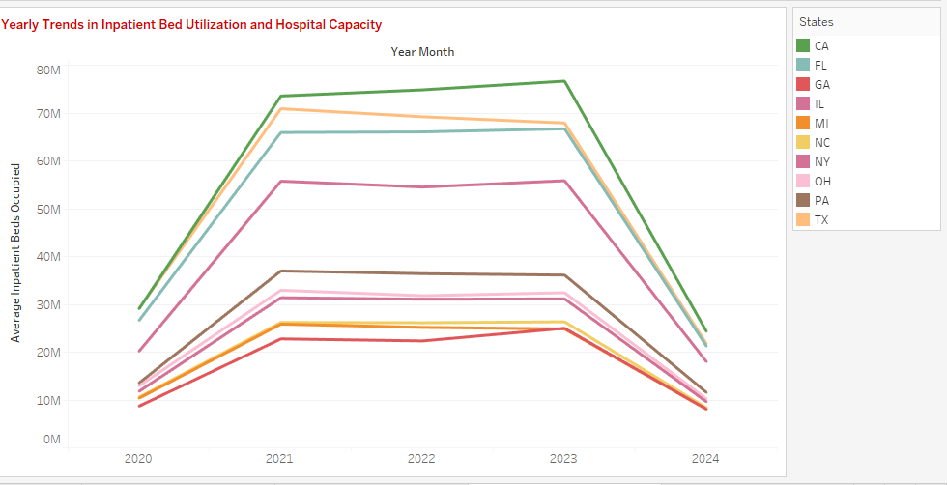
EDA (Explorative Data Analysis)

Slide 8
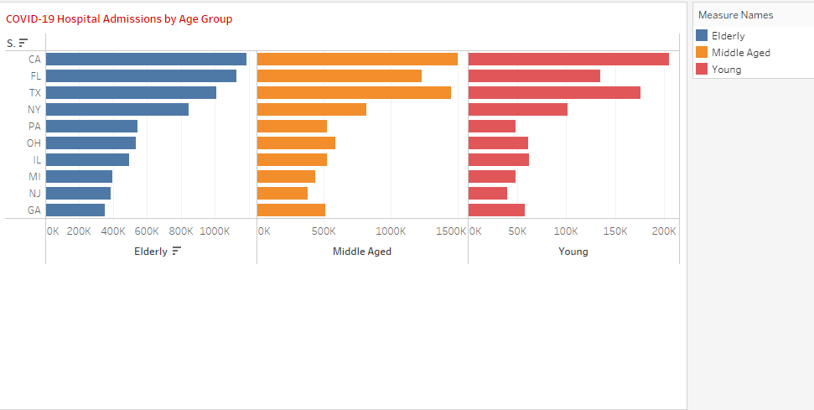
EDA Cont…

Slide 9
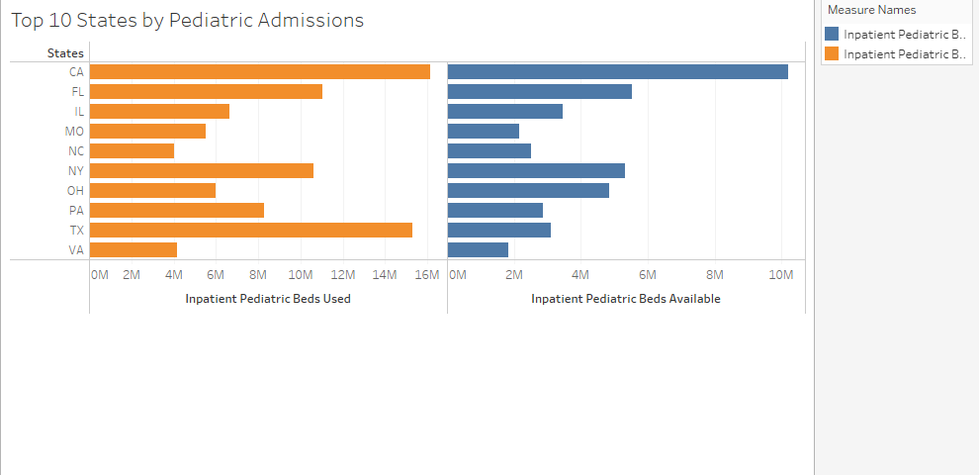
EDA cont…

Slide 10
EDA cont…

Slide 11

Feature Engineering and preprocessing
Comprehensive preprocessing included:
Date time indexing
ADF test – Check for stationarity for modeling (p-value <0.05)
PACF and ACF test for determining the correct lag features and guide towards ARIMA/SARIMA and the parameters to be used in modeling
Lag features (1 through to 5)
Moving averages & Exponential smoothing - capture short term, medium term & long-term trends and filter out the noise.

Slide 12
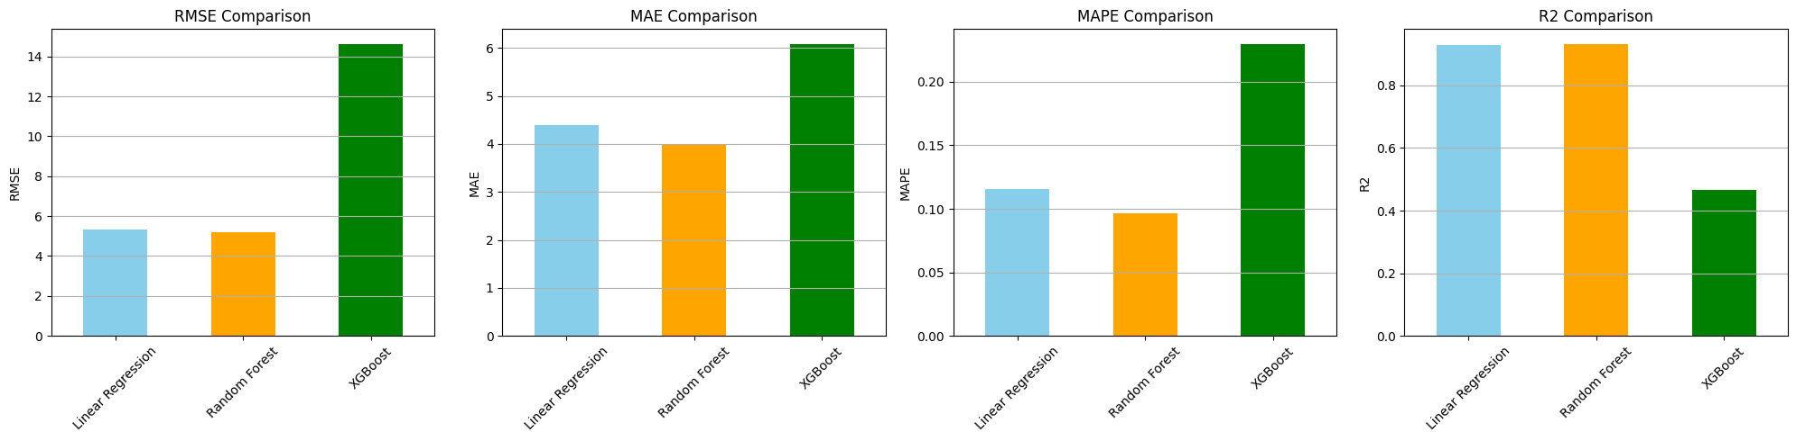
Modeling
Notes:
Naïve forecast is our baseline model
As seen in the next slides below, SARIMA was our best model.

Slide 13
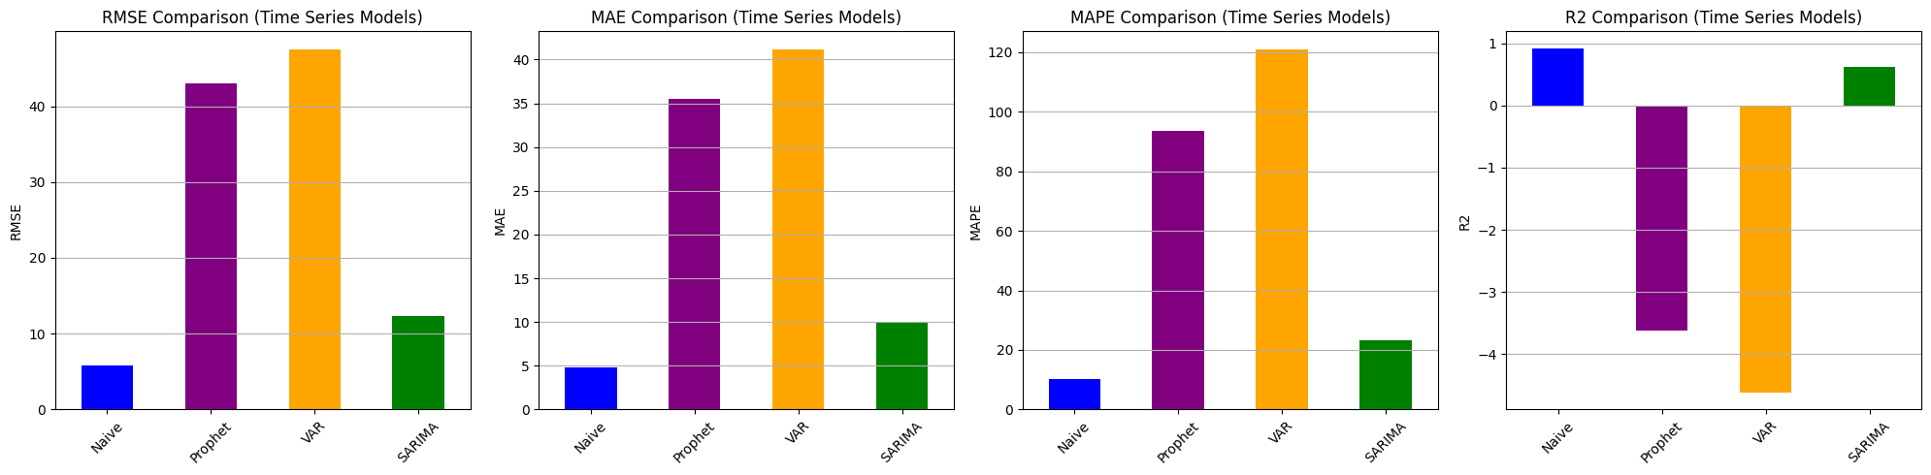
Modeling Cont…
Notes:
The SARIMA model has a Mean Absolute Error (MAE) of about 9.89 admissions, meaning it is off by roughly 10 patients on average. Its RMSE of 12.37 indicates that larger errors occasionally occur. This suggests that SARIMA captures seasonality and trends better than simple time series models.

Slide 14
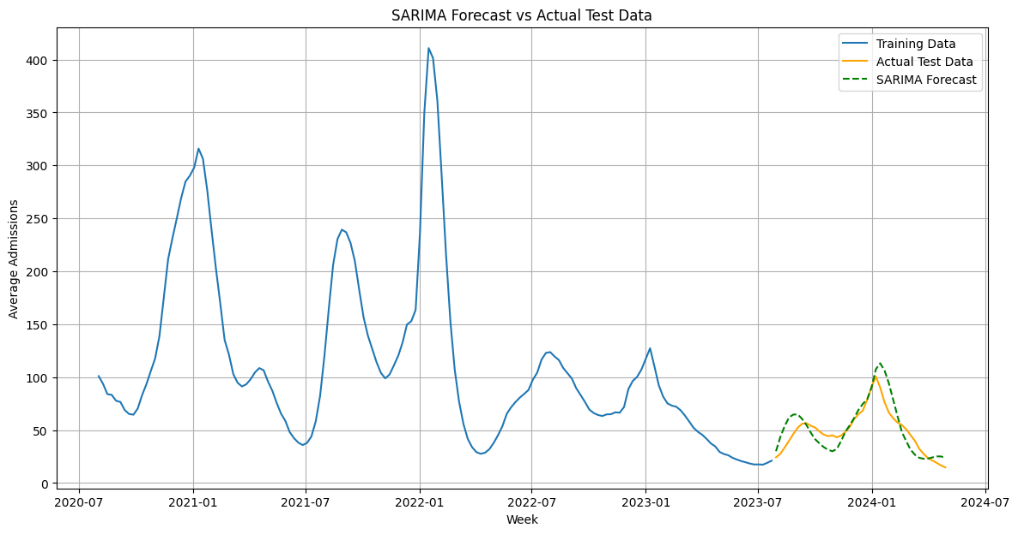
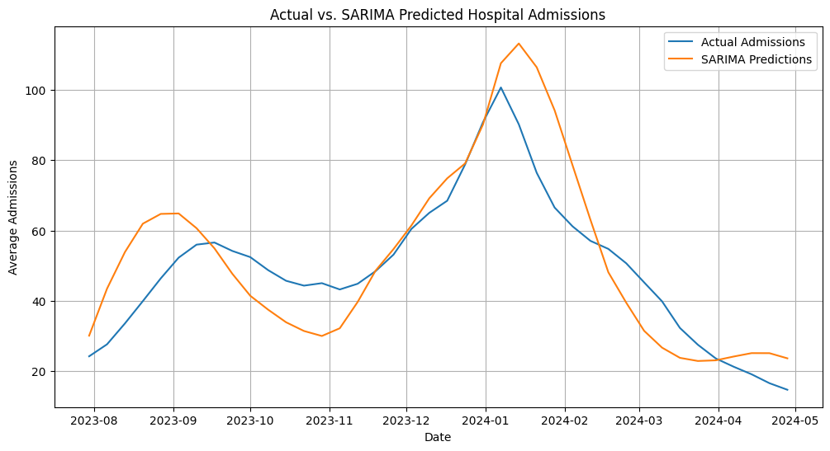
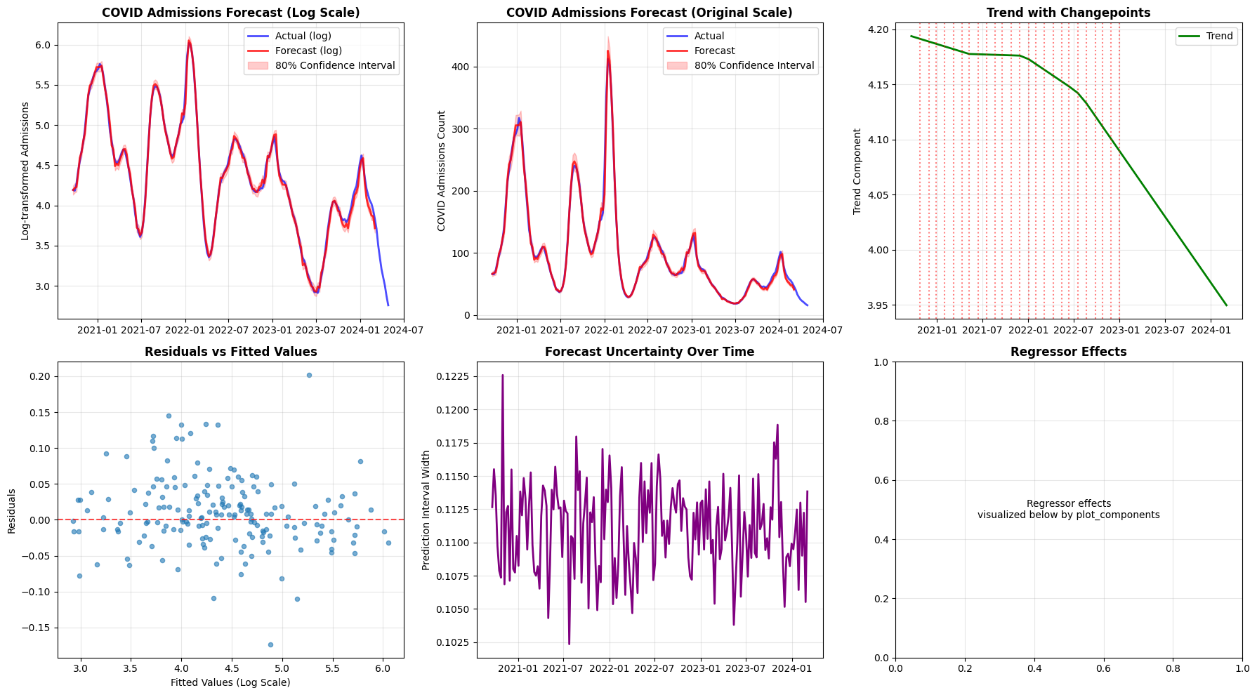

Slide 15
Evaluation Metrics
The main evaluation metric is MAE which is complemented by RMSE.
MAE still registers the error without letting it dominate overall metrics.
RMSE heavily penalizes mispredictions during surges and this gives extra weight to bigger mistakes.

Slide 16
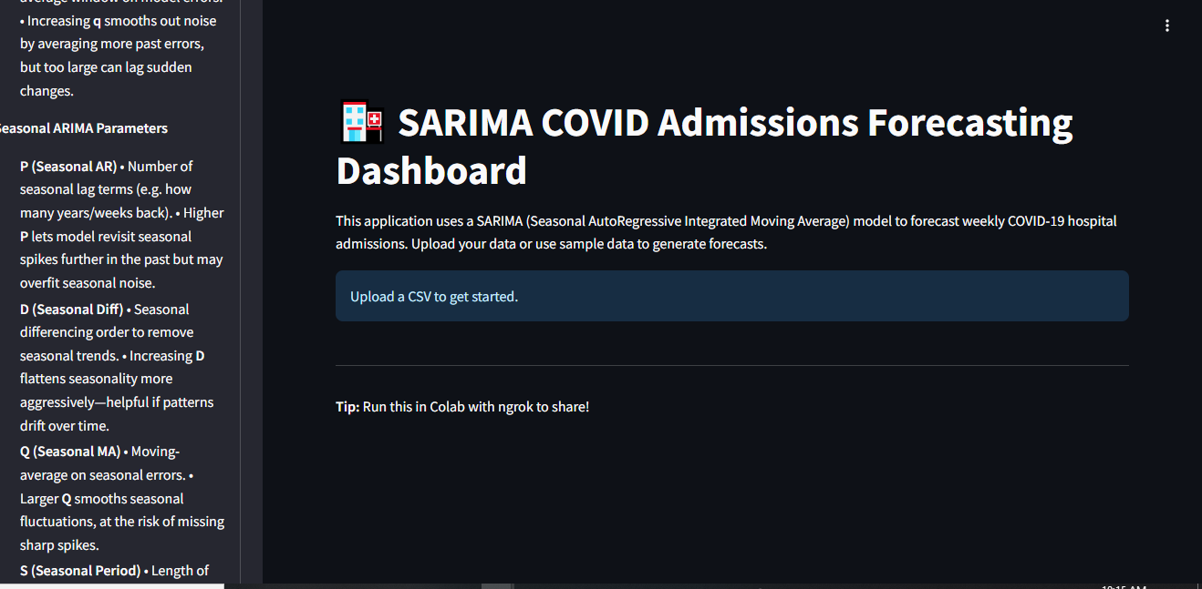
Deployment

Slide 17
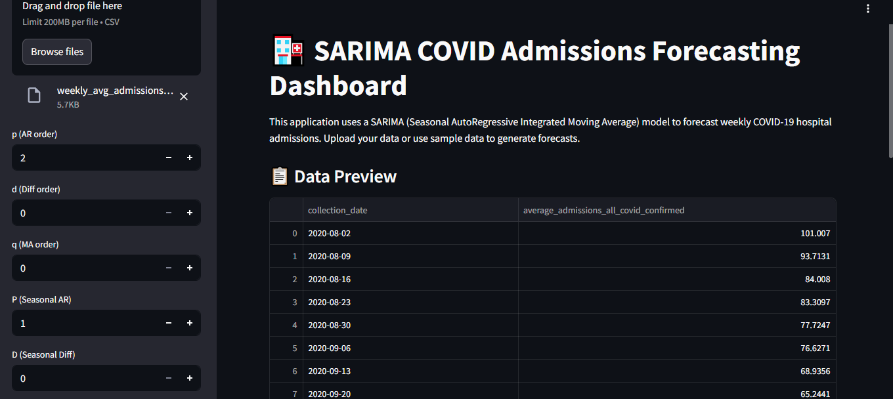
Deployment Cont…

Slide 18
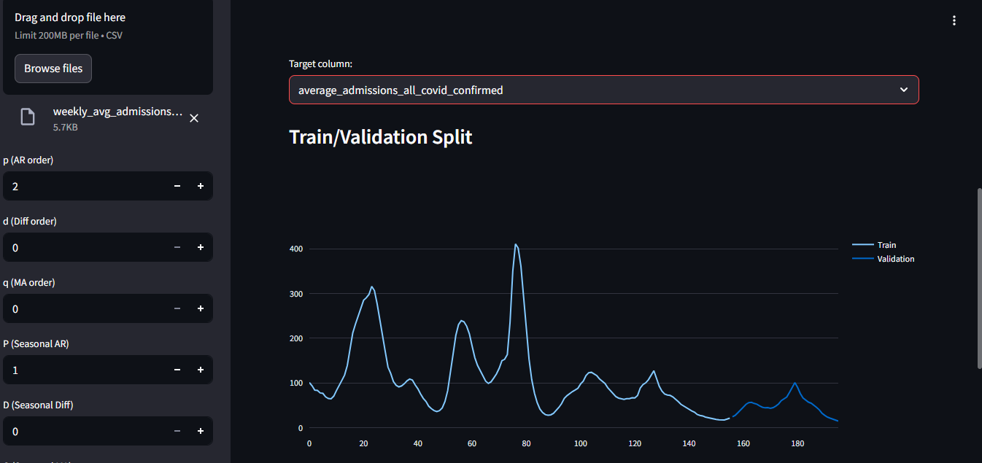
Deployment Cont…

Slide 19
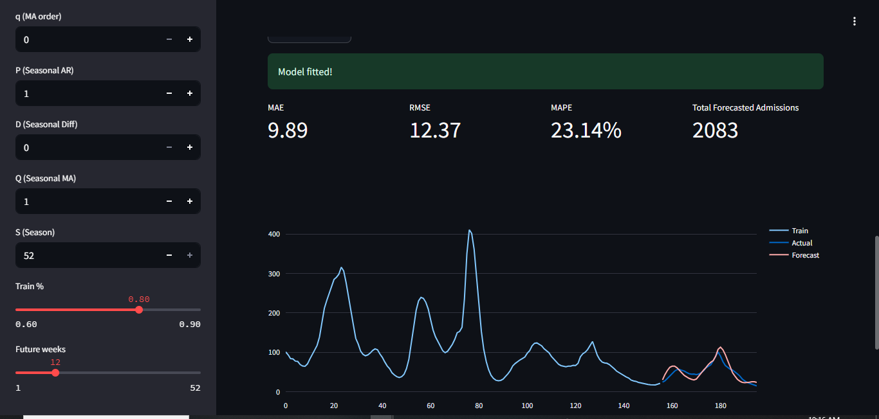
Deployment Cont…

Slide 20

Conclusion & Recommendations

Slide 21




Conclusion
Successfully integrated monitoring, modeling, and forecasting of COVID-19 hospitalizations.
Developed real-time dashboards for timely communication with public health stakeholders.
Produced short- and medium-term forecasts to support healthcare resource planning and policy decisions.
Identified seasonal patterns and trends across U.S. states.

Slide 22

Recommendations
Kenya should prioritize developing a centralized, real-time health data collect
Institutionalize Seasonal Surveillance and Early Warning Systems
Optimize Resource Allocation Based on Forecast Insights
Training for Local Public health agencies

Slide 23

THANK YOU!

